Slide 1
Chrono Timer
Group 1: SSJN
Sam, Shaun, Jess, Nate

Slide 2
Overview
Use Case
Domain Model
Sprint Designs and Challenges
Test Plan
Demonstration

Slide 3
Use Case

Slide 4
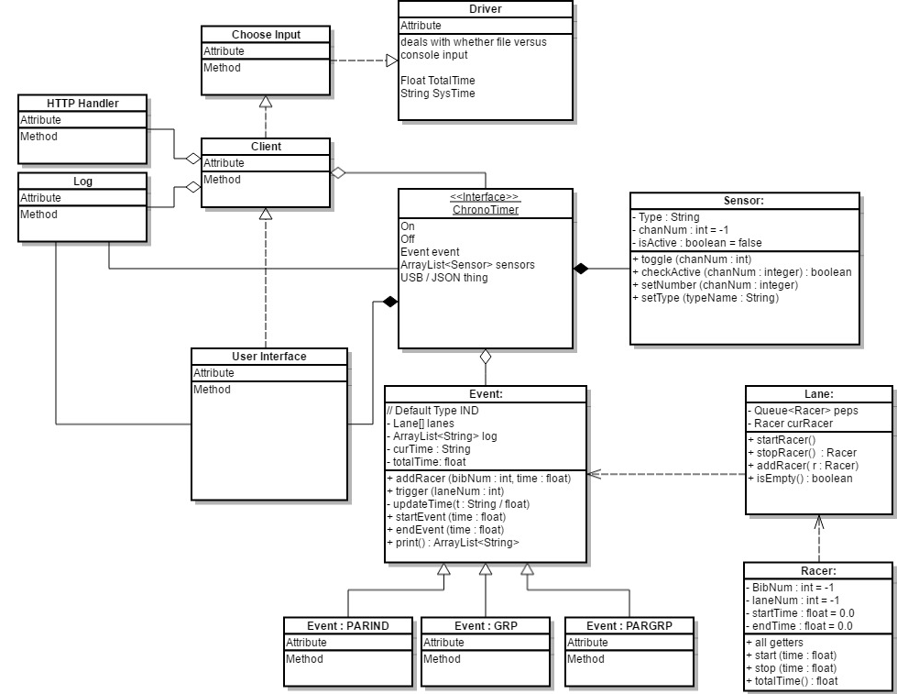
Domain Model

Slide 5
Initial Design: Sprint 1
Requirements: Basic functionality, IND race, IND special cases
Approach: Build skeleton of entire project
Challenges:
Scaled too large too fast
Confusion on purposes and interaction of different classes
Debate on which class had control/access/ownership of others

Slide 6
Rethinking Design: Sprint 2
Requirements: PARIND, USB export
Approach: Focused in fixing structure and only Sprint 2 updates
Challenges:
Clear domain model to reference
What went into Driver class and what stayed in the interface

Slide 7
Working Plan: Sprint 3
Requirements: GUI, GRP,
Approach: Divided members between GUI and functionality
Challenges:
Function menu in GUI
Sensor connect-disconnect

Slide 8
Adding Features: Sprint 4
Requirements: PARGRP, web server,
Approach: Continue working on previous section with new additions
Challenges:
Underestimated time requirements
Bug states

Slide 9
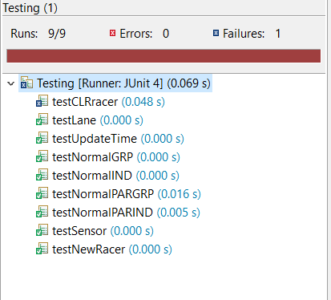
Test Plan
Class functionality
Each run
Unique cases

Slide 10
Demo
Each race type
Web server

Slide 11
Summary
Use Case
Domain Model
Sprint Designs and Challenges
Test Plan
Demonstration

